Slide 1


PyTorch
Payal Pitroda
OIM 7502 Mid Term Project

Slide 2

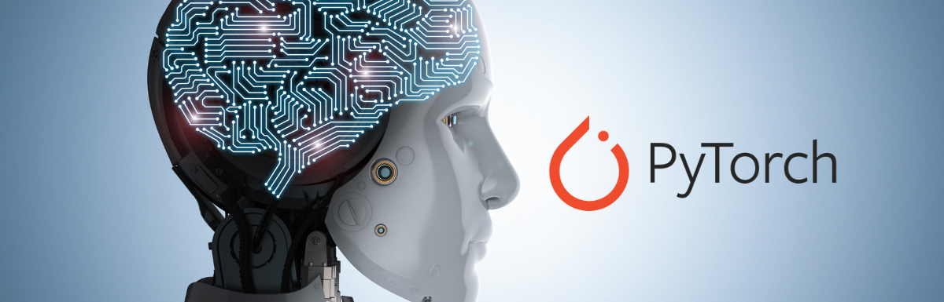
Introduction
PyTorch is a popular open-source machine learning library for Python. It provides a flexible framework for building and training deep learning models.
At its core, PyTorch provides two main features:
An n-dimensional Tensor, similar to numpy but can run on GPUs
Automatic differentiation for building and training neural networks
It is widely used for various applications such as natural language processing (NLP), computer vision, and reinforcement learning. PyTorch also offers dynamic computational graphs along with automatic differentiation.
Notes:
When training neural networks, the most frequently used algorithm is back propagation. In this algorithm, parameters (model weights) are adjusted according to the gradient of the loss function with respect to the given parameter.
To compute those gradients, PyTorch has a built-in differentiation engine called torch.autograd. It supports automatic computation of gradient for any computational graph.

Slide 3

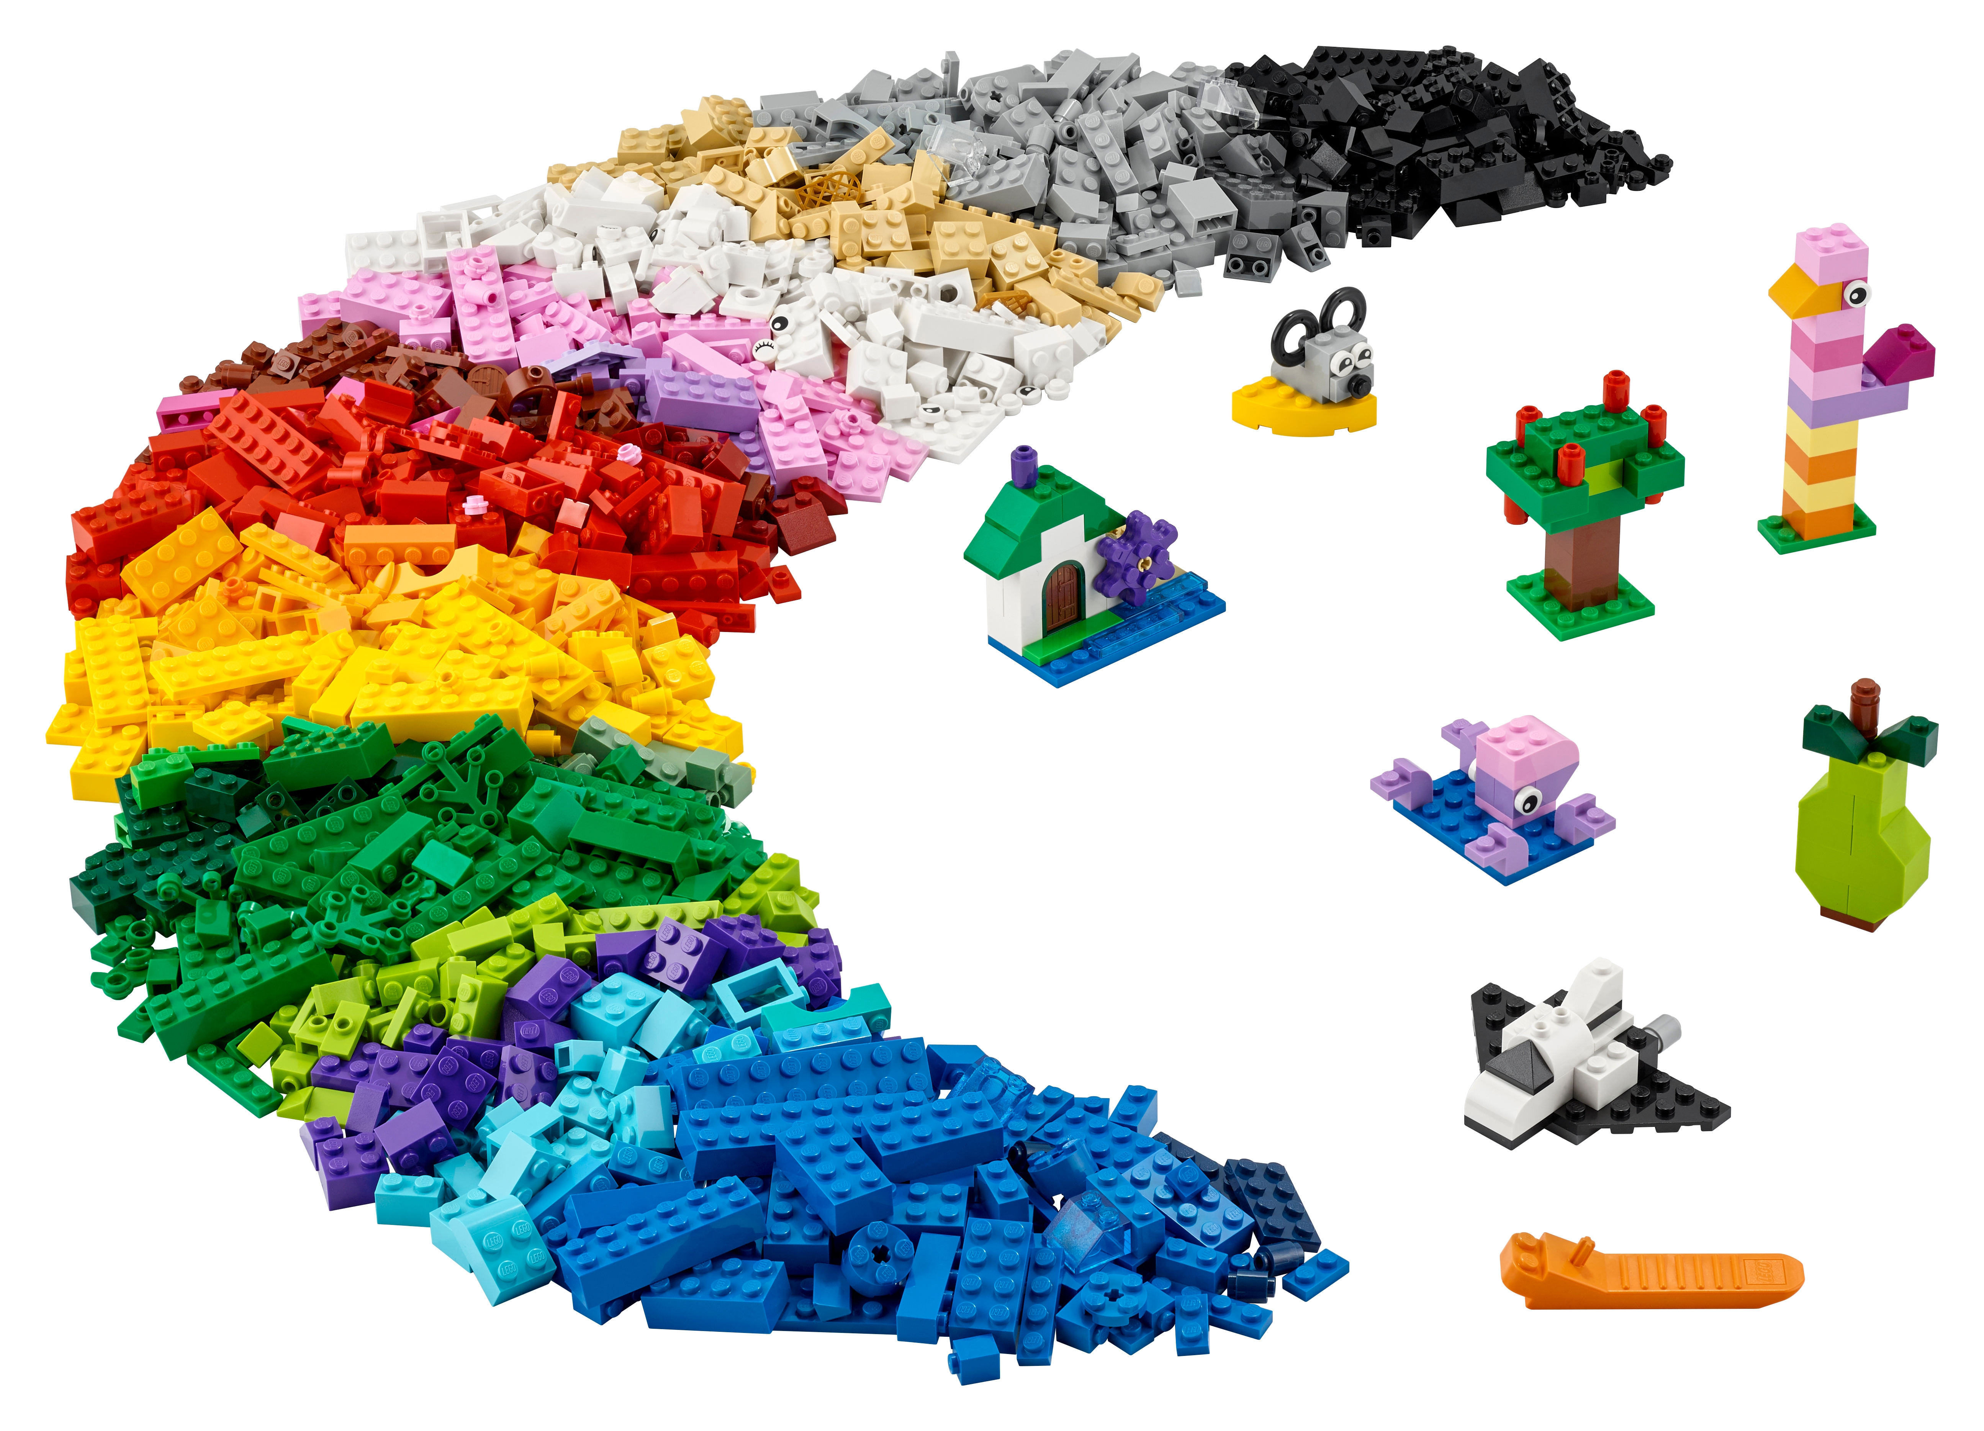

Understanding PyTorch
Tensors
1
3
2

Slide 4



Neural Network
PYTORCH
Notes:
Imagine you love playing with building blocks, but these blocks are special. They're called tensors, and they're like numbers that you can put together to build really smart things. PyTorch is like a super cool toolbox filled with special tools for playing with these tensors.
One of the coolest things you can build with PyTorch is called a neural network. It's like a blueprint for how to arrange these tensors to solve problems, like recognizing pictures of animals or predicting the weather.
But just like when you're building something with blocks, you need to practice and learn. In PyTorch, you train your neural network by showing it lots of examples and letting it adjust its tensors until it gets really good at its job. It's like practicing with your blocks until you build something amazing!
Once your neural network is trained, it can do all sorts of cool things, like telling you what's in a picture, understanding language, or even playing games. PyTorch helps you build and train these networks so you can make all kinds of smart and helpful stuff.

Slide 5
Functionality and Capabilities of PyTorch
Dynamic computational graphs: PyTorch allows the creation of computational graphs dynamically, meaning the graph is built on-the-fly as operations are executed. This makes it easier to debug models and experiment with different architectures.
Automatic differentiation: PyTorch's autograd package provides automatic differentiation for computing gradients of tensors. This feature is essential for training neural networks using techniques like backpropagation. This enables computing gradients of tensors with respect to some scalar value.
GPU acceleration: PyTorch supports seamless integration with graphics processing units (GPUs) for accelerating computations, enabling faster training of deep learning models on large datasets as GPUs can significantly speed up the training process.
TorchScript: PyTorch includes a Just-In-Time (JIT) compiler called TorchScript, which allows users to convert PyTorch models into a serialized representation that can be executed independently from Python, enabling deployment in production environments.

Slide 6
Functionality and Capabilities of PyTorch
4. TorchVision and TorchText: PyTorch offers additional libraries like TorchVision for computer vision tasks and TorchText for NLP tasks, providing pre-built datasets, models, and utilities to streamline the development process.
5. Python Interface: PyTorch is primarily designed to be used with Python. This means you can leverage the extensive capabilities of Python programming language to build, train, and deploy machine learning models using PyTorch.
6. Tensor Manipulation: At the core of PyTorch are tensors, which are multi-dimensional arrays similar to NumPy arrays but with additional functionalities. PyTorch tensors can be manipulated using Python syntax, making it easy to perform various operations such as arithmetic, indexing, slicing, and reshaping.
7. Deep Learning Modules: PyTorch provides a wide range of modules and utilities for building deep learning models, including layers, activation functions, loss functions, optimization algorithms, and more. These modules are designed to be highly customizable and can be easily combined to create complex neural network architectures.

Slide 7
Tensors are multi-dimensional arrays, similar to NumPy arrays, but they have additional functionalities that make them particularly useful in the context of deep learning and other numerical computing tasks. Tensors are a fundamental data structure used in frameworks like PyTorch, TensorFlow, and others. Here are some key points about tensors:
Multi-dimensional Arrays: Tensors can have any number of dimensions, including scalars (0-dimensional tensors), vectors (1-dimensional tensors), matrices (2-dimensional tensors), and higher-dimensional arrays.
Data Types: Tensors can hold data of various types, such as integers, floating-point numbers, and sometimes even strings or other data types depending on the framework. Common data types include float32, float64, int32, int64, and others.
Homogeneous Data: Unlike Python lists or NumPy arrays, tensors hold homogeneous data, meaning all elements in a tensor must have the same data type.
Tensors

Slide 8
Tensors
Operations: Tensors support a wide range of mathematical operations, including arithmetic operations (addition, subtraction, multiplication, division), linear algebra operations (matrix multiplication, matrix transpose, matrix inversion), element-wise operations (element-wise addition, element-wise multiplication), and more.
Broadcasting: Tensors support broadcasting, which means that operations can be applied to tensors of different shapes, and the framework automatically handles reshaping and broadcasting the tensors to match each other's shapes.
Device Placement: Tensors can be placed on different devices such as CPUs or GPUs for computation. This allows for efficient computation, especially for deep learning tasks where large amounts of data need to be processed in parallel.
Automatic Differentiation: Some tensor frameworks, like PyTorch, provide automatic differentiation functionality, allowing users to compute gradients of tensors with respect to some scalar value. This is essential for training neural networks using techniques like backpropagation.
In summary, tensors are a fundamental building block for numerical computations in deep learning and other scientific computing domains. They provide a versatile and efficient way to represent and manipulate multi-dimensional data, making them well-suited for a wide range of applications.

Slide 9
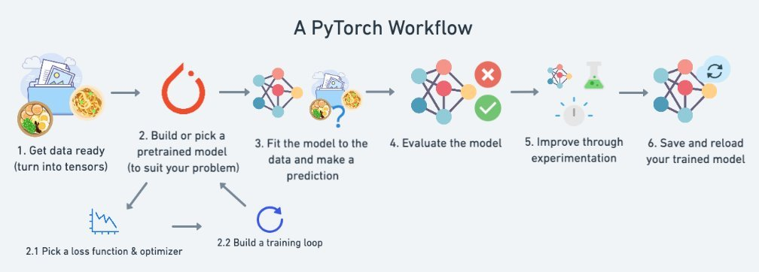
Where can we use Pytorch?

Slide 10
Data loading and processing
The first step in any data analysis project is to load and process the data. Pytorch offers several classes and functions for this purpose, such as Dataset, DataLoader, and transforms. A Dataset is an abstraction that represents a collection of data samples, such as images or texts. A DataLoader is an iterator that batches, shuffles, and distributes the data samples across multiple workers. Transforms are operations that modify the data samples, such as resizing, cropping, or normalizing. You can use these tools to create custom data pipelines for your specific problem domain.

Slide 11
Data exploration and visualization
The next step is to explore and visualize the data. Pytorch allows you to convert tensors to numpy arrays or pandas dataframes, which you can then use with libraries like matplotlib, seaborn, or plotly. You can also use tensorboard, a web-based dashboard that integrates with pytorch, to track and compare metrics, histograms, images, graphs, and more. Data exploration and visualization can help you understand the distribution, patterns, and relationships in your data, as well as identify outliers, errors, or anomalies.

Slide 12
Model building and training
The core of pytorch is its ability to create and train neural networks, which are powerful models for learning from complex and high-dimensional data. Pytorch offers a flexible and expressive API for defining and composing layers, activations, losses, and optimizers. You can also use torch.nn, a module that provides predefined layers and models for common tasks, such as convolutional, recurrent, or transformer networks. Pytorch also supports automatic differentiation, which simplifies the computation of gradients and backpropagation. You can use pytorch to build and train models for various data analysis problems, such as classification, regression, clustering, or generation.

Slide 13
Model evaluation and testing
The final step is to evaluate and test the model. Pytorch provides methods for saving and loading models, as well as performing inference on new data. You can also use torchmetrics, a library that implements various metrics for measuring the performance of your model, such as accuracy, precision, recall, f1-score, or roc-auc. You can also use torch.testing, a module that provides utilities for testing the correctness and consistency of your model and code. You can use these tools to assess the quality, robustness, and generalization of your model, as well as debug and improve it.

Slide 14
Real Life Examples
Tesla uses PyTorch for Autopilot, their self-driving technology. The company uses PyTorch to train networks to complete tasks for their computer vision applications, including object detection and depth modeling.
Microsoft is also a major PyTorch user. It’s the primary framework the company uses to develop machine learning solutions to improve Bing search and Xbox, among other products. What’s more, Microsoft also owns and develops the PyTorch for Windows applications and runs a cloud option of PyTorch through Microsoft Azure.
Airbnb uses PyTorch in their customer service department to create smart replies and recommend agent responses to customer requests.

Slide 15
Demonstration for Tensors

Slide 16
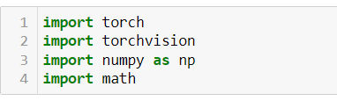
Import Pytorch

Slide 17
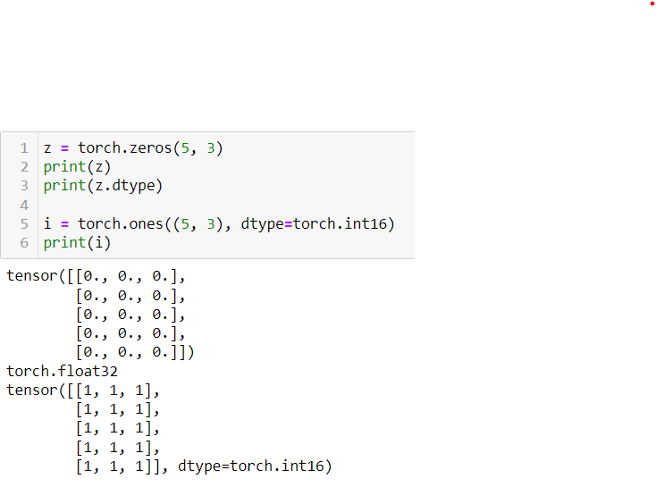
How to create a tensor?

Slide 18
Thank you

